Slide 1
Fuzzy based Sentiment Classification in the Arabic Language
Presenter: Mariam Biltawi
Princess Sumaya University for Technology, Jordan

Slide 2
Agenda
Definition
Used Dataset
Used Lexicon
Proposed Approach
Experiment and Results
Conclusion

Slide 3
Definition
Sentiment Analysis: refers to the task of identifying, individuals’ positive and negative opinions and emotions concerning a specific object such as an event, a product, a topic, or an individual, from a given data set.

Slide 4
Definition
Fuzzy logic: is a computing approach based on the degree of truth rather than the complete true or false values.
Fuzzy logic systems consist of five main steps:
Fuzzification.
Membership function design.
Design the fuzzy-rule.
Aggregation and accumulation.
Defuzzification.

Slide 5
Fuzzy logic in the field of Sentiment Analysis can be employed to classify the polarity of sentences or documents.

Slide 6
Objective
This research aims to propose a lexicon based approach, using fuzzy logic to enhance automatic polarity classification of text written in the Arabic language.

Slide 7
Used Dataset
The proposed approach is tested on Large Scale Arabic Book Reviews Dataset (LABR).
LABR is a Sentiment Analysis dataset of over 63,000 book reviews in Arabic collected from Goodreads website.
Review | Number
Positive Reviews | 42,831
Negative Reviews | 8,224
Neutral Reviews | 12,201

Slide 8
Used Lexicon
A large-scale Arabic sentiment lexicon (ArSenL) is used to assign weights for each token in the reviews.
Each Arabic word in the ArSenL lexicon is associated with three scores: positive, negative and neutral.
Each score has a value that ranges between 0 and 1.
For each word, multiple results with varying scores can be found.

Slide 9
Proposed Approach
PHASE 1

Slide 10
Proposed Approach
Preprocessing
Noise Removal
Normalization
Tokenization

Slide 11
Proposed Approach
Stanford Tagger
30 tags
Preprocessing
Feature Extraction
Two lookups were applied in case one fails:
1. Check for the token in its original form along with its POS.
2. Check for the stem of the token along with its POS.
A zero weight is given when no match is found
Map 30 tags into 3 main tags:
Verb
Noun
article
POS Tagging
POS Mapping
Weight extraction
the total weight is computed for each POS tag comprising the sentence; verb, noun, and article

Slide 12
Proposed Approach
Preprocessing
Feature Extraction
Crisp value
Each review will have three crisp values; noun, verb, and article.

Slide 13
Proposed Approach
PHASE 1
Crisp value
PHASE 2

Slide 14
Proposed Approach
PHASE 1
Crisp value
Fuzzification
Linguistic Variable | Type | Linguistic Values (Fuzzy set)
Verb | Input | High Positive, Low Positive, Neutral, Low Negative, High Negative.
Noun | Input | High Positive, Low Positive, Neutral, Low Negative, High Negative
Article | Input | Positive, Neutral, Negative
Polarity | Output | Strong Positive, Weak Positive, Neutral, Weak Negative, Strong Negative.
The universe of discourse ranges from -10 to 10, which represents the weights for the words

Slide 15
Proposed Approach
Membership function design
PHASE 1
Crisp value
Fuzzification
Triangular membership functions and piece-wise membership functions are used for modeling the linguistic values for each linguistic variable.

Slide 16
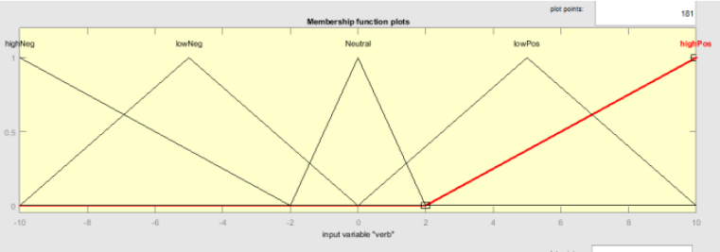
Proposed Approach
Membership function design
PHASE 1
Crisp value
Fuzzification

Slide 17
Proposed Approach
Membership function design
PHASE 1
Crisp value
Fuzzification
fuzzy rules were built in order to link the input and output variables together
Total number of rules = Number of “Verb” linguistic values
* Number of “Noun” linguistic values
* Number of “Article” linguistic values
= 5 * 5 * 3
= 75 rules.
Linguistic Rules design

Slide 18
Proposed Approach
Membership function design
PHASE 1
Crisp value
Fuzzification
If (verb is highPos) and (noun is highPos) and (article is Positive) then (polarity is strongPos) If (verb is highPos) and (noun is lowPos) and (article is Positive) then (polarity is strongPos) If (verb is highPos) and (noun is Neutral) and (article is Positive) then (polarity is strongPos) If (verb is highPos) and (noun is highNeg) and (article is Positive) then (polarity is weakPos) If (verb is highPos) and (noun is lowNeg) and (article is Positive) then (polarity is weakPos) . . .
Linguistic Rules design

Slide 19
Proposed Approach
Membership function design
PHASE 1
Crisp value
Fuzzification
Aggregation aims to aggregate the fuzzy value of each input variable in order to apply the rule. The rules used in our approach mainly use AND in their antecedent part.
Accumulation aims to combine the outputs derived from all applied fuzzy rules into one fuzzy set. Here, Mamdani method is applied, which uses the maximum accumulation method to combine the outputs for each rule.
Aggregation and Accumulation
Linguistic Rules design

Slide 20
Proposed Approach
Membership function design
PHASE 1
Crisp value
Fuzzification
Aims to map the output fuzzy set into a crisp values in order to determine the final polarity of the sentence.
Centroid defuzzification method is used
Aggregation and Accumulation
Linguistic Rules design
Defuzzification

Slide 21
Proposed Approach
Membership function design
PHASE 1
Crisp value
Fuzzification
Aggregation and Accumulation
Linguistic Rules design
Defuzzification
Polarity

Slide 22
Proposed Approach
PHASE 1
Crisp value
PHASE 2
Polarity

Slide 23
Experiment
Three approaches were tested:
The proposed approach using the three variables; verb, noun, and article.
The proposed approach using only two variables; verb and noun.
Lexicon-based approach with no fuzzy technique.
In the lexicon-based approach the same steps of phase 1 is applied on the reviews and the weight were summed at the end and checked for its polarity.

Slide 24
Experiment
Two experiments were conducted for each approach:
Considering all sentiment polarities; positive, negative, and neutral;
Considering only two sentiment polarities; positive and negative.
In the second experiment, the neutral polarity is neglected, thus as a result the number of rules used were decreased.

Slide 25
Experiment
 | Number of variables | Number of rules
Experiment 1 | 3 | 5*5*3=75
 | 2 | 5*5=25
Experiment 2 | 3 | 4*4*2=32
 | 2 | 4*4=16

Slide 26
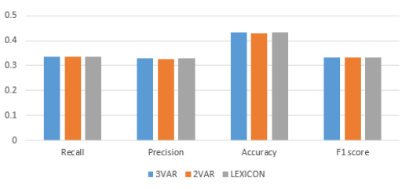
Experiment (1) Results
The best accuracy is given by the proposed approach and it reached: 43.28%

Slide 27
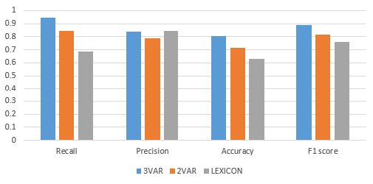
Experiment (2) Results
The best accuracy is given by the proposed approach and it reached: 80.59%

Slide 28
Experimental results
The proposed approach performs well when the neutral polarity is neglected,,
When neutral polarity is considered accuracy decreases, because not all the words of the Arabic language is contained in the lexicon, since the proposed approach relies on the weights conducted from the lexicon.

Slide 29
Conclusion and Future Work
Fuzzy-based Arabic sentiment analysis approach was proposed.
Overall, the proposed approach outperforms the lexicon-based approach.
As a future work, we are testing the algorithm on other datasets in order to perform a comprehensive comparison.

Slide 30
Thank you

